Slide 1

EXPERIMENT
Aim of Experiment: To measure the object/obstacle distance through Ultrasonic Sensor using Arduino Microcontroller

Slide 2
What is an Ultrasonic Sensor?
An ultrasonic sensor is an instrument that measures the distance to an object using ultrasonic sound waves.
An ultrasonic sensor uses a transducer to send and receive ultrasonic pulses that relay back information about an object’s proximity.
High-frequency sound waves reflect from boundaries to produce distinct echo patterns.
How Ultrasonic Sensors Work?
Ultrasonic sensors work by sending out a sound wave at a frequency above the range of human hearing. The transducer of the sensor acts as a microphone to receive and send the ultrasonic sound. Our ultrasonic sensors, like many others, use a single transducer to send a pulse and to receive the echo. The sensor determines the distance to a target by measuring time lapses between the sending and receiving of the ultrasonic pulse.

Slide 3
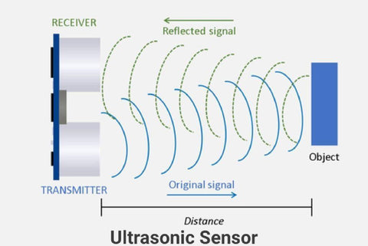
SLIDE NO. - 2

Slide 4
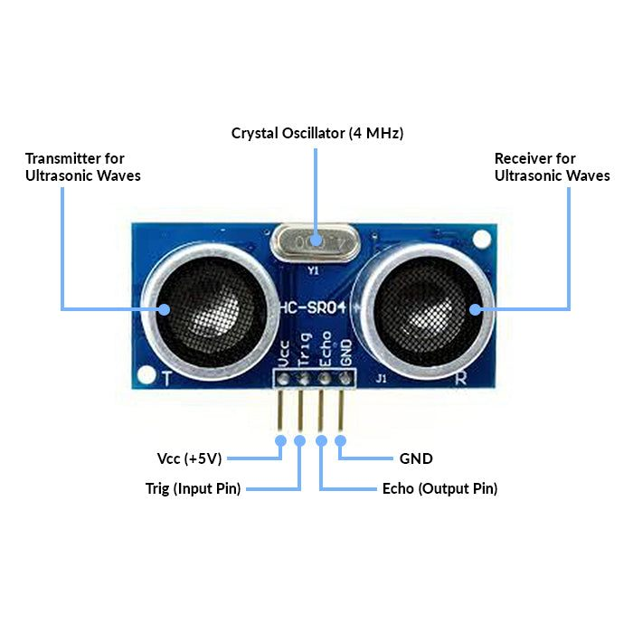
SLIDE NO. - 3

Slide 5
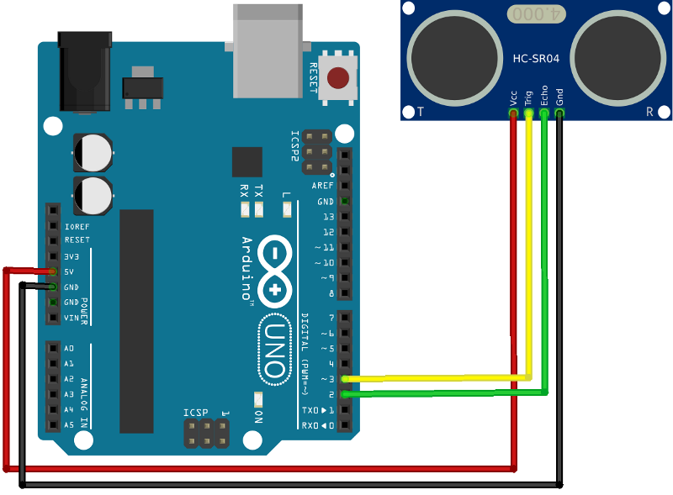
SLIDE NO. - 4

Slide 6
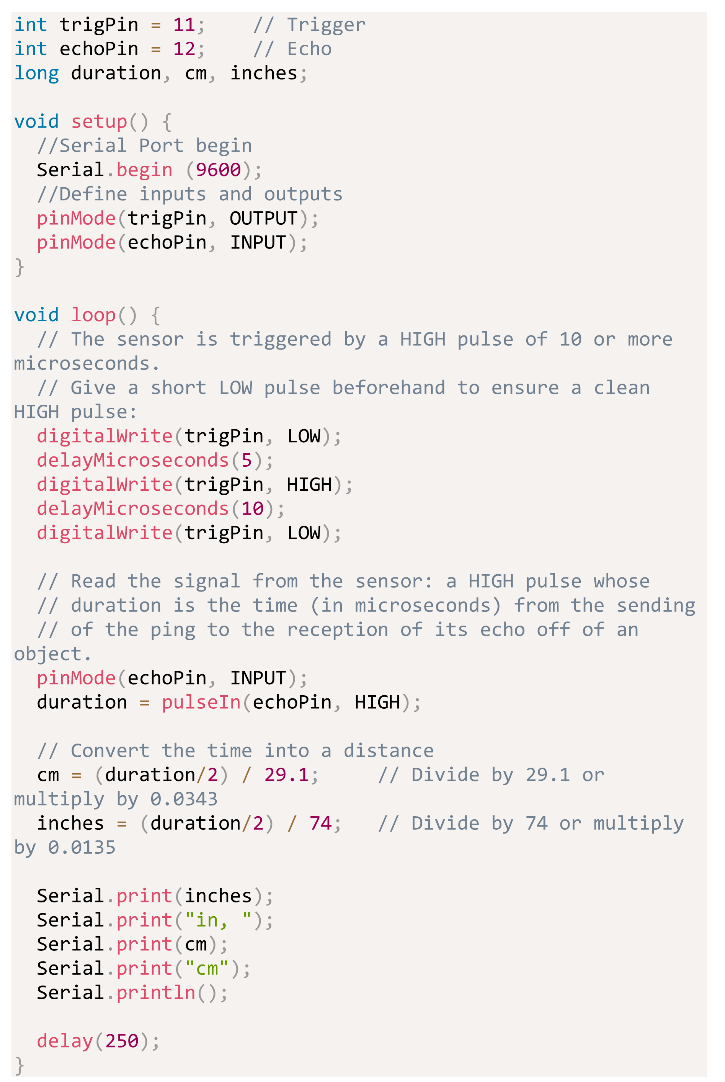
SLIDE NO. - 4

